Slide 1
Conditional forms
Dr Julia Miller
English for Uni
www.adelaide.edu.au/english-for-uni

Slide 2

The teaching materials in this PowerPoint presentation have been developed by Dr Julia Miller and are available on the English for Uni website.
The grammatical content of the materials is largely based on Celce-Murcia, M., & Larsen-Freeman, D. (1999). The grammar book (2nd ed). US: Heinle & Heinle. pp. 548, 552.
Funded by the Australian Government Office for Learning and Teaching.
Notes:
http://www.adelaide.edu.au/english-for-uni/conditionals/

Slide 3
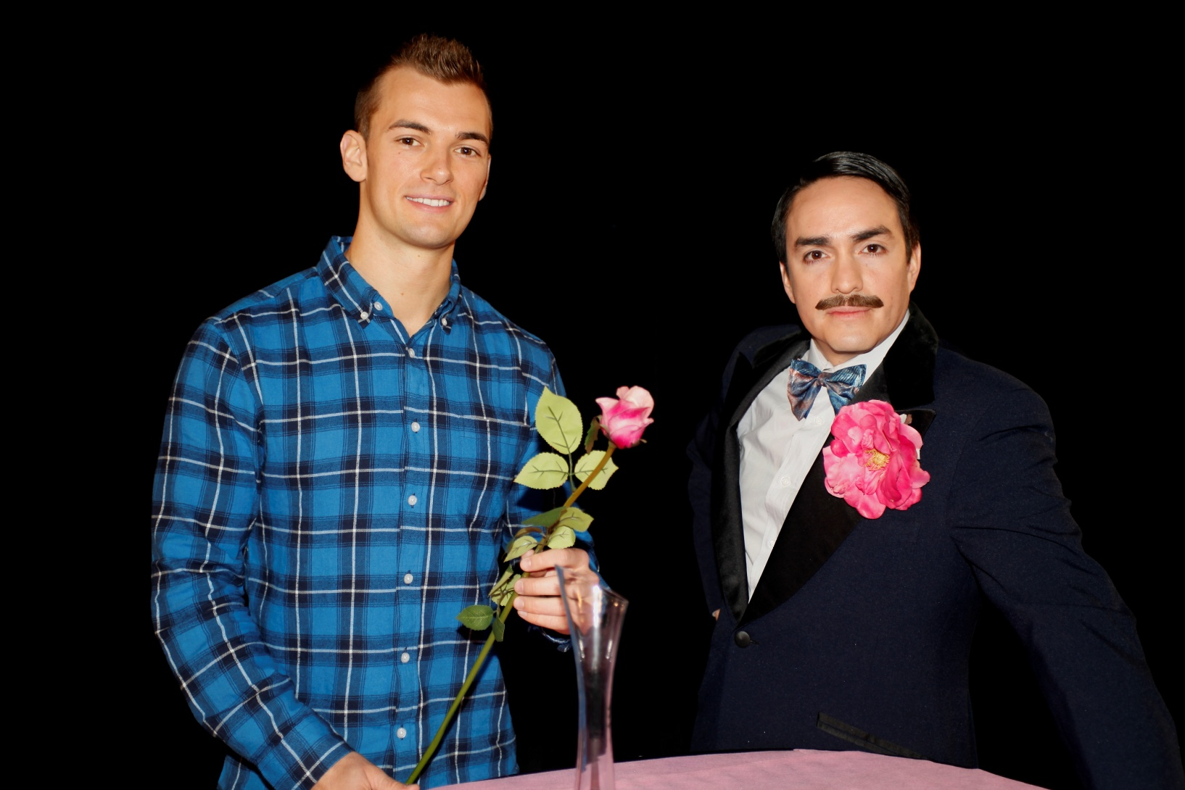
If You Love Me
Please click on the photo above to go to the If You Love Me TV show video
Notes:
Click on the photo to go straight to the If You Love Me TV show video on YouTube: https://www.youtube.com/watch?v=Rzvj__F4nCc&feature=youtu.be&list=PLrj2iJKdUdbzz1VPbd2RpcAEdsyXy3tik
You will need to change the link to this one (http://v.youku.com/v_show/id_XODUxNDgzOTQ4.html) to see the whole video on youku.
Play the If You Love Me video story up to the end of the dating show (4:34).

Slide 4
What language feature was the focus of that story?
Look at the title again: If You Love Me
What language form is if?
  Answer: a conditional form
When do we use a conditional form in English?
  Answer: when we are not certain if something has happened or will happen
Notes:
Click to see each line appear

Slide 5
Wong says: I studied maths at the University of TransOceania last year. If you were there, you might have seen me.
Were you there?
  No.
Did you see him?
  No.
Could you possibly have seen him?
  Yes, but only if you had been there.
Notes:
Play the story again from 0:20 to 0:46 (‘If you were there, you might have seen me’.) Discuss this sentence.

Slide 6
If you were there, you might have seen me.
This sentence describes a possible, hypothetical situation. It’s a situation that did not happen.
What other situations can you describe with if sentences?

Slide 7
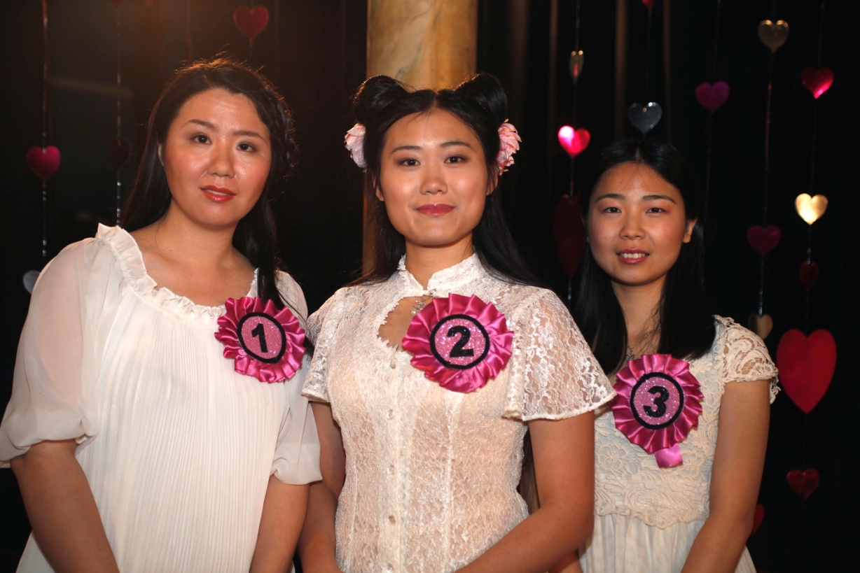
Now watch the rest of the video story again and note down any if expressions.
Please click on the photo above to go to the If You Love Me TV show video
Notes:
Click the picture to start the YouTube clip at 0:18 seconds. http://www.youtube.com/watch?v=Rzvj__F4nCc&t=0m18s

Slide 8
What if expressions did you find?
If you like this man, please vote now.
If my mother were here, she would say you are a nice boy!
Even if I had homework, I still helped them with their fish farm.
If I can look after a fish, I can look after a girl!
If you had had more money when you were younger, would you have bought a fast car?
If I had had more money, I would have given it to my parents.
If you always give, you will always have.

Slide 9
If you walk on snow, you cannot hide your footprints.
What would you do if you found your ideal girl?
I always try to be honest and kind, if I can be. If I’m correct, you have no more questions for him.
If you heat water to 100°C it boils.
If you see the right girl, you know.
Go and take her hand if you want to go with her.
If not, say ‘thank you’ and leave without her.

Slide 10
Did you notice any conditional expressions that used words other than if?
I like you, even though you studied maths and I studied history.
Even if I had homework, I still helped them with their fish farm.
whenever I see someone in trouble, I like to help them.
I think you should always stop and help someone, unless they are too dangerous.
I want to find a girlfriend, otherwise I will be lonely.
Provided that we are both honest with each other and communicate well, I think we could be very happy.
As long as she doesn’t bring her pet snake to live with us, she’s the one for me.

Slide 11
How do we use conditional forms in English?
Factual conditionals can be timeless (outside time, expressing habits or scientific facts) or time-bound (referring to present, past or different times).
Future conditionals can express a strong or weak condition or result (something will happen or may happen) or be used to give advice or commands.
Imaginative conditionals can be hypothetical (unlikely but possible in the present or future) or counterfactual (impossible, referring to present or past time).
(Celce-Murcia, M., & Larsen-Freeman, D. (1999). The grammar book (2nd ed). US: Heinle & Heinle. pp. 548, 552)

Slide 12
Factual conditionals
 | Factual
 | Timeless
Generic |  | Habitual
Outside time |  | Present or past time
Present tense |  | Present or past tense; or would + infinitive
e.g. If you heat water to 100°C, it boils. |  | e.g. If I estimate the results first, it always helps. If we misinterpreted the results, we indicated this immediately.
Scientific facts |  | Habits
1 |  | 2
Notes:
Chart based very closely on Celce-Murcia, M., & Larsen-Freeman, D. (1999). The grammar book (2nd ed). US: Heinle & Heinle. pp. 548, 552 and used with permission.

Slide 13
Factual conditionals
 | Factual
 | Time-bound
All times |  | Past time
Same or different tenses or modals |  | Present or past tense; or would + infinitive
e.g. If you create a spreadsheet, you can formulate the results more easily. If you legislate for xxx, it could occur. If you researched the area, you must have realised the problem before we did. |  | e.g. If they financed the project, they may have distributed the product too.
Implications |  | Inferences
3 |  | 4
Notes:
Chart based very closely on Celce-Murcia, M., & Larsen-Freeman, D. (1999). The grammar book (2nd ed). US: Heinle & Heinle. pp. 548, 552 and used with permission.

Slide 14
Factual conditionals
 | Future (predictive)
Strong condition or result |  | Weakened condition or result
Future time |  | Present or future time
Present + future tenses; or present + imperative |  | Present tense + other modal + infinitive
e.g. If you analyse the results, you will define the problem more clearly. If you proceed with the experiment, interpret the findings carefully. |  | e.g. If you assess the data thoroughly, you might establish the cause of the problem. If you benefit from the study, you should identify the key factors in its success.
Predictions. Commands |  | Possible plans. Advice
5 |  | 6
Notes:
Chart based very closely on Celce-Murcia, M., & Larsen-Freeman, D. (1999). The grammar book (2nd ed). US: Heinle & Heinle. pp. 548, 552 and used with permission.

Slide 15
Imaginative conditionals
 | Imaginative
 | Hypothetical (unlikely but possible)
Present or future time
Past tense + modal + infinitive; or were to + infinitive + modal + infinitive
e.g. If you exported the table, it would require too much data. If I were to process all this data, I would structure the resulting graph very carefully.
Present or future dream
7
Notes:
Chart based very closely on Celce-Murcia, M., & Larsen-Freeman, D. (1999). The grammar book (2nd ed). US: Heinle & Heinle. pp. 548, 552 and used with permission.

Slide 16
Imaginative conditionals
 | Factual
 | Counterfactual (impossible)
Present time |  | Past time
Past tense+ modal + infinitive |  | Past perfect tense + modal + have + past participle
Present tense |  | Present or past tense; or would + infinitive
e.g. If Einstein were alive today, he would solve the problem. |  | e.g. If you had contextualised the argument it would have been more useful.
. . . but he isn't. |  | . . . but you didn’t.
8 |  | 9
Notes:
Chart based very closely on Celce-Murcia, M., & Larsen-Freeman, D. (1999). The grammar book (2nd ed). US: Heinle & Heinle. pp. 548, 552 and used with permission.

Slide 17
Exercise 1
How could you rewrite the following sentences using the suggested alternative conditional words? There are many possible answers.
e.g. as long as
I'll go if you go too
Answer: I'll go as long as you go too.
Notes:
Exercise 1 from the website. Do this online, or work through in class using the downloadable exercise and suggested answers.

Slide 18
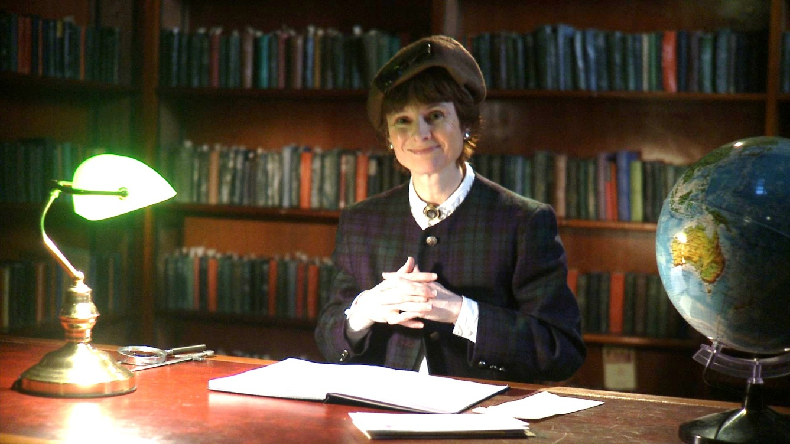
Teaching on conditionals
Notes:
Watch the teaching section of the video story. Click on picture to go to YouTube clip, or copy and paste this link:
https://www.youtube.com/watch?v=ZBL2vGaChm4&feature=youtu.be&list=PLrj2iJKdUdbzz1VPbd2RpcAEdsyXy3tik

